Slide 1

Notes on the Hungarian data collection, 2010
Gábor Molnár & Zsófia Papp
Centre for Social Sciences
Hungarian Academy of Sciences
Winners and Losers in the Elections of Eastern Europe
Workshop 2
March 18, 2014

Slide 2
Contents
Gathering electoral data for 2010 (Gábor)
Matching candidates (Zsófi)

Slide 3
Gathering electoral data

Slide 4
About the source
National Elections Office’s website
Underlying data structure
Database not given
Goal: recreating the database

Slide 5
What was available?
Queries by:
  Candidates
  Districts
  Party lists
Aggregate statistics

Slide 6
Main tasks
Obtaining a list of individual candidates

Slide 7
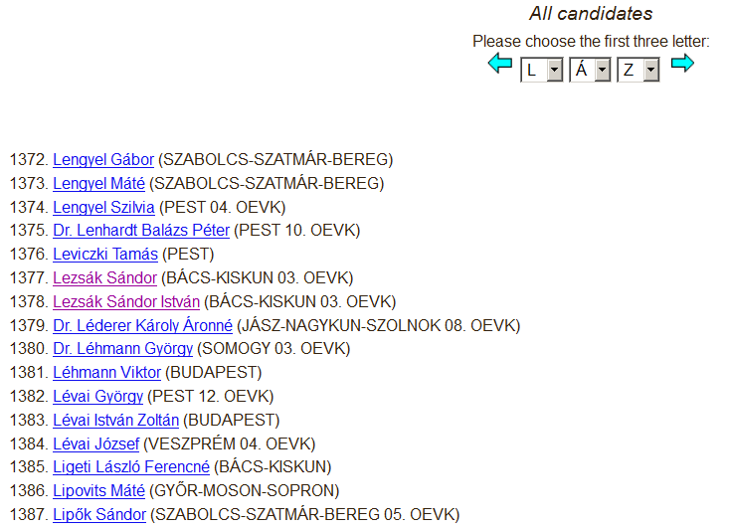
Saving the complete list
Problem: duplicates

Slide 8
Extracting IDs from hyperlinks
Function HLink(rng As Range) As String
If rng(1).Hyperlinks.Count Then HLink = rng.Hyperlinks(1).Address
End Function
LINK | NAME
http://valasztas.hu/dyn/pv10vt/vertaj-static/pv10vt/jaz/4/7/9/j51-ja1266396954799.html | Adorján Béla
http://valasztas.hu/dyn/pv10vt/vertaj-static/pv10vt/jaz/8/8/4/j51-ja1266311548846.html | Alexa György
http://valasztas.hu/dyn/pv10vt/vertaj-static/pv10vt/jaz/3/0/9/j51-ja1266488143098.html | Ambrus Tibor
→ Filtering unique IDs
→ Selecting the most informative names

Slide 9
Main tasks
Obtaining a list of individual candidates
Importing all available data

Slide 10
Importing data
Extracting addresses (as previously seen)
Saving and merging pages
Pasting pages to Excel
Labeling cases
Filtering unneeded rows

Slide 11
Main tasks
Obtaining a list of individual candidates
Importing all available data
Linking data to individuals
  LookUp and VBA through unique links
Checking aggregate results

Slide 12
Obtained data
Tier(s) of candidacy
  SMD (county and number)
  Regional list + position
  National list + position
  District magnitude
  List length
Party affiliation(s)
  Separately for each tier
  Nominating party
Votes received (number and proportion)
  Separately for each round
  SMD level: individual + party list
  Regional level
Mandate won

Slide 13
Candidate matching

Slide 14


What we (do not) have
1990-2006 candidate dataset (original data) – EastPac
A list of 2010 candidates (names, gender, IDs and profile links) – Gábor
We do not have the official year of birth data for 2010.

Slide 15
Stages of matching
Recoding the name variable
Problem: the list of names in the original dataset was not compatible with the 2010 list, because…
Candidates do not seem to be consistent in terms of how they use their names
The original dataset did not display characters like ő and ű, whereas the 2010 candidate list did.
Solution: building names from components (prefix, family name, middle name, maiden name, first name, extra name). → automated and manual coding

Slide 16
Stages of matching
Recoding the name variable
Batyikné Csőke Ágnes Erzsébet
Family name | Middle name | Maiden name | First name | Extra name
Batyikné |  | Csőke | Ágnes | Erzsébet
The basis of matching

Slide 17
Stages of matching
Initial matching
SORT CASES BY familyname(A) firstname(A) middlename(A) maidenname(A) extraname(A).
MATCH FILES /FILE=*
/FILE='DataSet2'
/RENAME (prefix = d0)
/BY familyname firstname middlename maidenname extraname
/DROP= d0.
EXECUTE.

Slide 18
Stages of matching
The need to double-check
Candidates with identical names (names that come up more than once over time)
Problems:
Candidates classified as newcomers might match a candidate from the previous elections
Candidates matched to candidates from the previous elections might not be the right matches
  they might be newcomers
  they might be matches of other candidates
2) Candidates with names that have only come up once before
Problem: 2010 candidates matched to candidates from the previous election might be actually newcomers
3) Candidates with unique names (no problems involved)

Slide 19
Candidates classified as newcomers might match a candidate from the previous elections
1990-2006 |  | 2010
Kovács Ferenc
Kovács Ferenc
Kovács Ferenc
 |  | Kovács Ferenc Sándor

Slide 20
Candidates matched to candidates from the previous elections might not be the right matches
  they might be newcomers
  they might be matches of other candidates
1990-2006 |  | 2010
Kovács Ferenc |  | Kovács Ferenc
Kovács Ferenc
Kovács Ferenc
1990-2006 |  | 2010
Kovács Ferenc |  | Kovács Ferenc
Kovács Ferenc
Kovács Ferenc

Slide 21
All the above in more complicated ways
1990-2006 |  | 2010
Kovács Ferenc |  | Kovács Ferenc
Kovács Ferenc |  | Kovács Ferenc
Kovács Ferenc |  | Kovács Ferenc
 |  | Kovács Ferenc

Slide 22
Decision heuristics for manual matching
Year of birth (if available)
Party affiliation and county of nomination
SMD of nomination
Local political background (if available)
Candidate photos (!)
Sources:
National Elections Office → www.valasztas.hu
National and local newspapers
Candidate and party websites
Facebook pages

Slide 23
The numbers
Number of candidates (1990-2006): 13 652
Number of candidates (2010): 2498
Based on the initial matching:
Unique names: 1368 → To be checked: 1130
Newcomers: 1479
Falsely classified newcomers: 109
Matched but turned out to be newcomers: 250
Matched but turned out to be matches to different candidates: 16
Final version:
Newcomers: 1610
Matches: 888

Slide 24
Thank you for your attention!

